Slide 1
Reducing GHG and Pollution Loads in LMI /Disadvantaged communities
M. Wei, LBNL
8/30/17
Notes:
GHG= greenhouse gas pollution; LMI = low, middle incom
Pollution can include criteria emissions (NOx, Sox, PM2.5, PM10), VOC, ROG, ozone, etc.

Slide 2
Lit Search
Mapping GHG, Crit Emissions, H/E damages
Measures/costs
Kleeman
Florin: meas /costs // any other activity level mapping by AQD

Slide 3
Problem statement
The state is aggressively pursuing greenhouse gas (GHG) reduction through building energy efficiency, clean electricity, electrified transport, and other measures; and has aggressive GHG 2030 targets in SB32 and SB350, SB1383, etc.
Environmental pollution is still an urgent problem in the Central Valley and other LMI (low middle income) and disadvantaged communities; and more funds from Cap and Trade are earmarked for disadvantaged communities
But current policies may not be providing lower GHG with lower pollution
E.g. focusing on building energy efficiency or light duty vehicles may not help much for overall pollution in the Central Valley
Biomass based plants are zero GHG but can be heavy polluters
How best to develop policies and prioritize deployments to balance both GHG reduction and pollution reduction in the Central Valley and other LMI/disadvantaged communities?

Slide 4
Target – Paper in Energy Policy
Scoping/framework paper
Challenges in reducing pollution and GHG in disadvantaged communities in CA
Literature review e.g. PV, EV ownership by income
Existing policies and trends
Documenting criteria pollution in Central Valley
Key conflicts and challenges in reducing GHG and pollution
Preliminary assessment of GHG vs environmental damages by sector/source e.g., LD/HD Transport vs buildings vs industrial sources
Discussion of preliminary costs of implementing alternative approaches, e.g. energy efficiency vs LD/ HD Transport.
Potential policy implications and prioritized areas for follow up work.
Notes:
We could aim higher, but then would probably need national scope beyond CA.
LD, HD = light duty, heavy duty

Slide 5
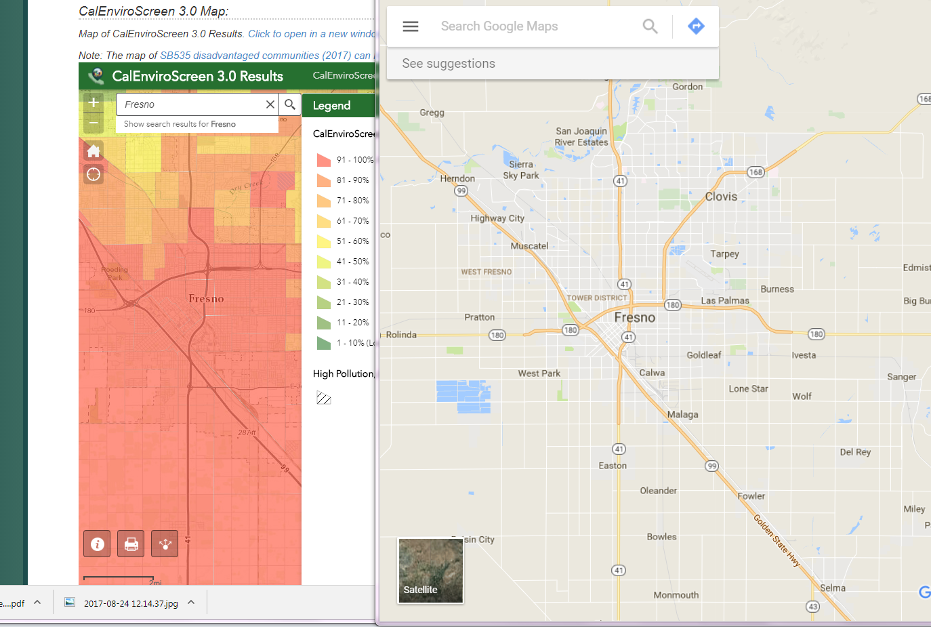
Example LMI / Disadvantaged Community : San Joaquin Valley, Fresno County
City of Fresno : mostly 90%-100% score on CalEnviroScreen3.0

Slide 6
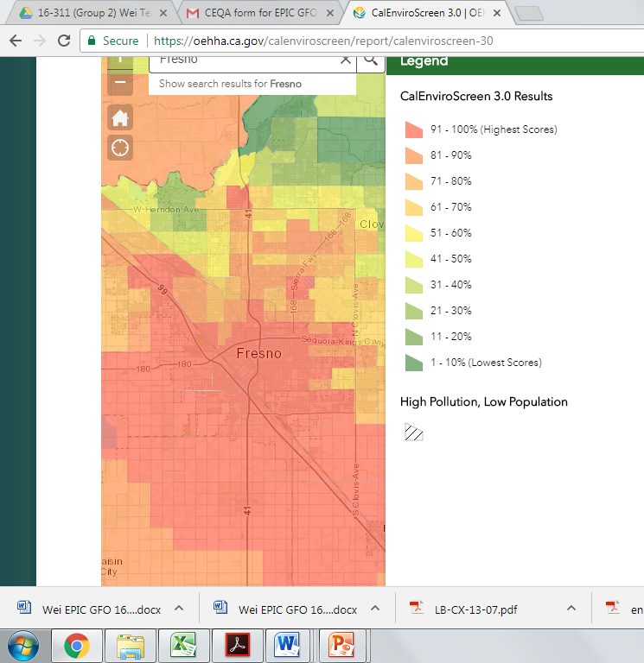
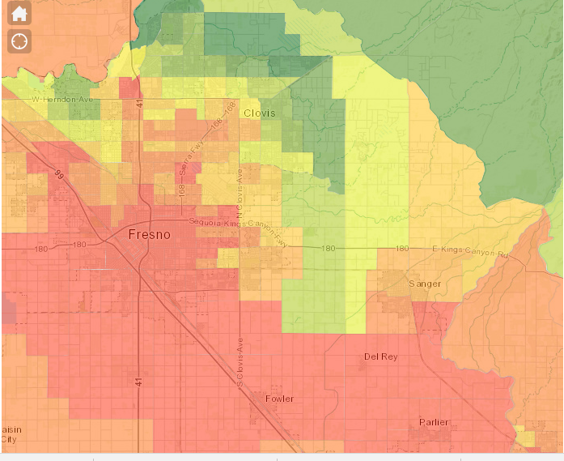
71-
75%

Slide 7
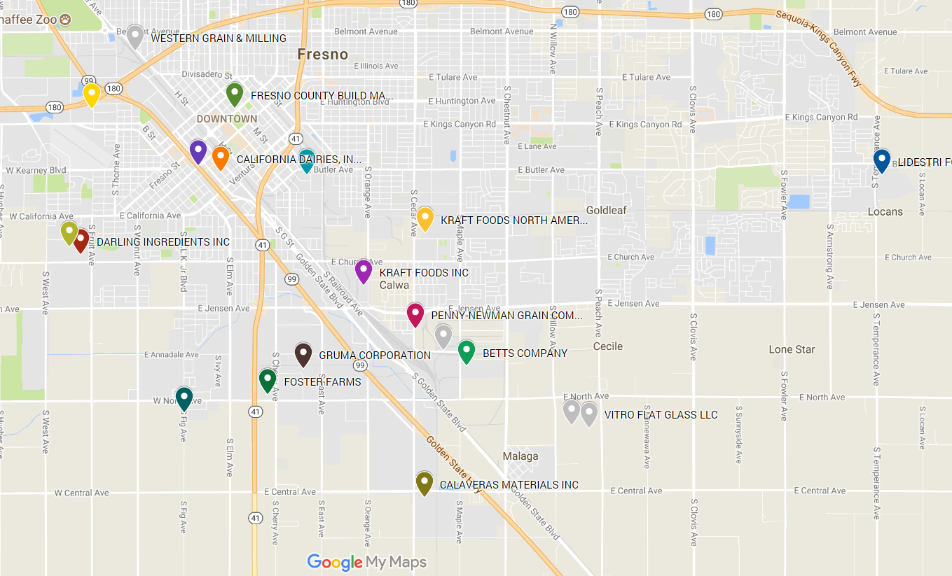
Example: Many Industrial sites and 2 Power Plants in Fresno
FNAME | NOXT | SOXT | PMT | PM10T
VITRO FLAT GLASS LLC | 340.4 | 52.0 | 19.3 | 18.8
RIO BRAVO FRESNO [24MW biogas plant] | 100.8 | 0.5 | 50.2 | 41.5
BROWNING FERRIS INDUSTRIES | 3.6 | 1.2 | 16.9 | 3.2
E & J GALLO WINERY | 3.2 | 0.6 | 29.6 | 14.9
CALIFORNIA DAIRIES, INC. | 8.3 | 0.7 | 10.6 | 5.9
FRESNO/CLOVIS REGIONAL WWTP | 2.6 | 5.7 | 1.3 | 1.3
SAINT AGNES MEDICAL CENTER | 6.8 | 0.2 | 2.0 | 2.0
KRAFT FOODS INC | 1.8 | 0.3 | 2.0 | 2.0
MALAGA POWER, LLC - 121 MW peaking plant NG | 4.2 | 0.2 | 1.6 | 1.6
DARLING INGREDIENTS INC | 4.1 | 0.2 | 1.1 | 1.1
Rio Bravo Power Plant
Malaga Power Plant
Rio Bravo Biomass Power Plant: Zero emissions for GHG but is a
High Criteria pollution source located in a dense urban area

Slide 8
Tasks
Build upon existing work by Florin/Alex for sources of pollution and pollution GIS mapping; and Dev Millstein’s health and environmental damages data.
Literature review – send any data/papers to
Pull pollution sources in high scoring CalEnvirascreen 3.0 Areas e.g. San Joaquin Valley (Fresno County, Kern County, etc.) and LA County from ARB database, similar to the data set below for Fresno County
Dev Millstein of LBNL can provide health and environmental impacts by source
Analysis: Generate charts of GHG by sector/sources vs health and environmental Impacts by sector/source
Explore costs of mitigation by sector source, e.g. trucking electrification vs light-duty vehicle electrification
Synthesis: work with LBNL/UCB researchers to formulate take-aways and potential policy implications

Slide 9
Charts
Bar Chart Thumbnail of GHG, Pollution, and H/E Benefits by county.

Slide 10
Prior work
For transportation, we used emissions outputs from EMFAC model for transportation emissions in 2020, 2030, 2040, 2050. These emissions then used to calc health/env damage factors in 2020, 2030.
Dev has calculated damage factors by vintage and vehicle type in 2030
Florin James Langer also mapped the spatial source of these transportation emissions using a gridded inventory from UC-Davis
Some sample maps on next slide
These use UC-Davis gridded emissions for road dust as a proxy for transportation activity (Michael Kleeman)
A lot of this work needs further data analysis and synthesis.
Can go over these data sets with Zemei…

Slide 11
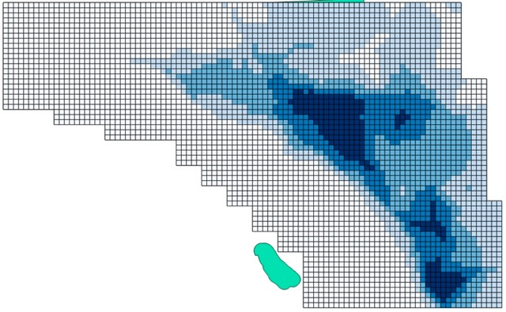
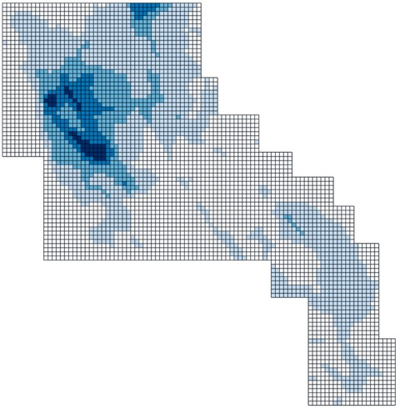
Example – Preliminary Spatial Mapping of Transportation Emissions
LA County San Joaquin County

Slide 12
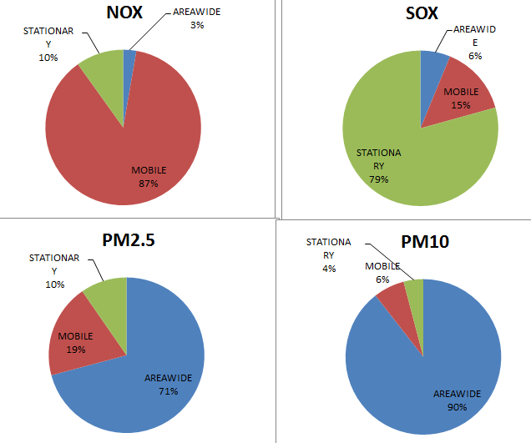
Example of Pollution Sources by Sector: Fresno County Criteria Pollution – Sources are very mixed and each category is important
NOX : MOBILE dominates
SOX : STATIONARY dominates
PM2.5,10 – AREA dominates
Ref: ARB 2012
Notes:
SJValley Indus pollution file

Slide 13
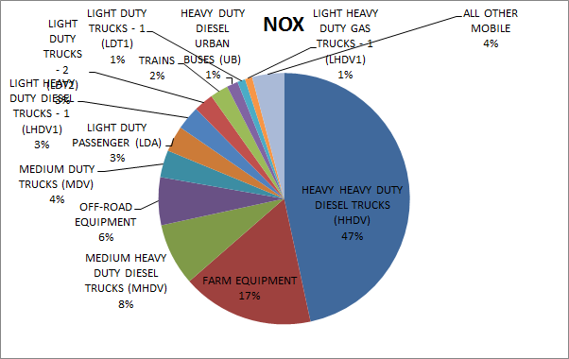
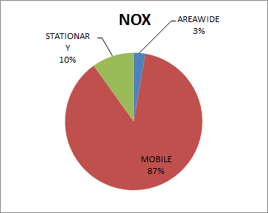
NOX
Heavy, Medium duty trucks + Farm equipment: 76%
LD passenger, LD trucks: 6.8%

Slide 14
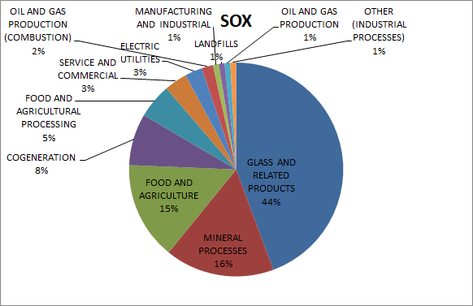
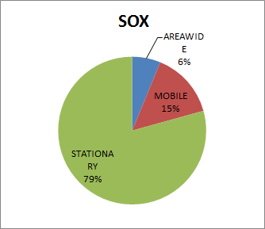
Stationary SOX
Industry dominates: Glass, Mineral, Food/ag, Food processing are 80%

Slide 15
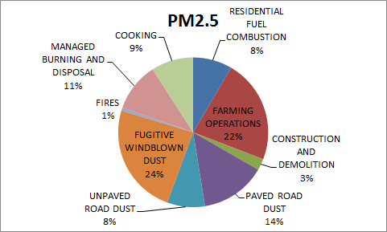
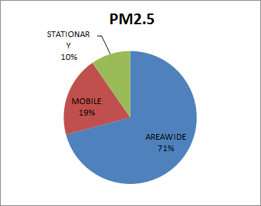
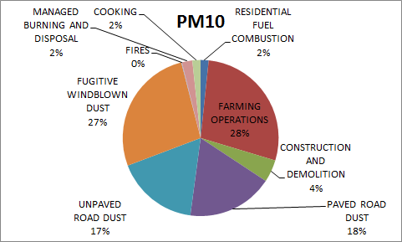
PM2.5, PM10
PM2.5: 68% dust and farming operations; ~17% residential: cooking, resid. fuel combustion
PM10: 90% road dust and farming operations; ~ 4% residential: cooking, resid. fuel combustion;

Slide 16
Some considerations/questions
What are the GHG and health/environment benefits for “cleaning up” different sectors vs some expected costs
E.g. what is relative cost/benefit of electrifying a diesel medium duty truck vs. a light duty vehicle?
How can a biomass plant be shut down in a dense urban area? Reducing local electricity demand may or may not impact the local plant operation, and there may be long term contracts.
Emissions from Waste combustion plants?
How should the state approach large industrial sources such as glass making in the Central Valley? (Max)
How to balance these pollution improvements with Jobs/economic impacts (qualitative)

Slide 17
TASK 2: Data Collection,
Analysis and Synthesis
Months 1-8
TASK 3: Technology Options
and Scenario Analysis
Months 8-20
TASK 4: Action Plan and
Recommendations
Months 18-24
Project Start
4/18 approx
Project End
4/20 (24 mo.)
Community
Workshop 1
Month 2 or 3
Community Workshop 2
After Task 3 screening analysis
Completed ~ Month 14
Community Workhop 3
~Month 21
Community Survey
and Deployment
Months 4-7
Note: Task 1 is General Administrative Tasks

Slide 19
High
Local Biomass
Power Plant
Local Air
Pollution
Emissions
(Criteria
Pollutants)
Degraded local
outdoor air quality
Distant Biomass
Power Plant
Low
Small impact
on local outdoor
air quality
ZERO
High
State Inventory
GHG Emissions

Slide 20
Degraded local
outdoor air quality
Degraded local
outdoor air quality
Diesel Trucks
ICE Vehicles
High
Industrial
Sources
Local Biomass
Power Plant
Local Gas Peaker
Power Plant
Local Air Pollution
Emissions (Criteria Pollutants)
High Energy-
Efficient
Buildings
Low Energy-
Efficiency
Buildings
Zero Low
Solar PV,
Wind,
Electric Vehicles
Zero Low
High
State Inventory GHG Emissions
Improved local
outdoor air quality

Slide 21
High
Local Gas Peaker
Power Plant
Local Air
Pollution
Emissions
(Criteria
Pollutants)
Degraded local
outdoor air quality
Solar PV, DR &
Storage
Low
Improved local
outdoor air quality
ZERO
High
State Inventory
GHG Emissions

Slide 22
High
Local Air
Pollution
Emissions
(Criteria
Pollutants)
Low Energy-
Efficiency
Buildings
High Energy-
Efficient
Buildings
Low
Small impact on local outdoor air quality;
Larger impact on indoor air quality
Lower
Higher
State Inventory
GHG Emissions

Slide 23
High
Local Air
Pollution
Emissions
(Criteria
Pollutants)
Low Energy-
Efficiency
Buildings
Low
Electrified
Buildings
Some impact on local outdoor air quality
from less combustion; less impact
on indoor air quality
Lower
Higher
State Inventory
GHG Emissions

Slide 24
Diesel Trucks
ICE Vehicles
High
Local Air
Pollution
Emissions
(Criteria
Pollutants)
Degraded local
outdoor air quality
Low
Electric Trucks
Electric Vehicles
Improved local
outdoor air quality
Low
High
State Inventory
GHG Emissions

Slide 25
High
Industrial Pollution
Sources
Local Air
Pollution
Emissions
(Criteria
Pollutants)
Degraded local
outdoor air quality
Low
Electrified Industrial
Factories
Improved local
outdoor air quality
Low
High
State Inventory
GHG Emissions

Slide 26
Some possible takeaways
The state should not allow combustion plant in closed air basins such as the Central Valley, even if they are “zero-GHG” biomass plants
The state should focus more on mitigating pollution from industrial sites
The RESIDENTIAL sector seems to contribute a small portion of criteria pollutants ~ 10% or less. Still, what can be done here?
Resid. cooking and fuel combustion
Indoor air quality/ infiltration/filtering, etc for health benefits
Transportation options to reduce LD vehicle and LD truck emissions
Can we do anything about major sources in short term (5-10 years)
Transportation HD/MD trucking? Electrify shorter range MD Trucks; but not long range HD; roadway mapping/planning?
Industry SOX – Focus on Glass plants and other high polluting sites
PM: road dust, farming op? Probably out of scope for energy planning.

Slide 27
references
Google street air pollution mapping: http://pubs.acs.org/doi/abs/10.1021/acs.est.7b00891
More to add…

